Slide 1
Chapter 29

Slide 2
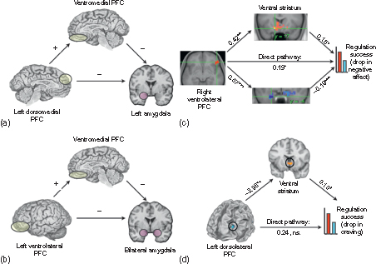
Figure 1 Two kinds of mediation pathways involved in reappraisal. (a) and (b) show pathways identified in two studies of the down-regulation of negative emotion whereby dorsomedial or ventrolateral prefrontal regions diminish amygdala responses via their impact on ventromedial prefrontal cortex. These studies did not report weights for the mediation paths between regions or test for full versus partial mediation. (c) and (d) show pathways identified in two studies of the down-regulation of negative or positive emotion, whereby ventrolateral or dorsolateral prefrontal regions diminish self-reports of negative affect or craving via their impact on the amygdala or ventral striatum, respectively. *p<0.05, **p<0.01, ***p<0.001
Reproduced from Ochsner KN, Silvers JA, Buhle JT. Functional imaging studies of emotion regulation: a synthetic review and evolving model of the cognitive control of emotion. Ann NY Acad Sci. 2012;1251:E1–E24.

Slide 3
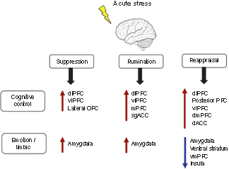
Figure 2 Summary of brain activity involved in suppression, rumination, and reappraisal when exposed to acute stress. During all three emotion regulation techniques there is activation in a variety of frontal cortical regions involved in cognitive control. However, only reappraisal results in a decrease in activity of brain areas involved in emotion generation and processing (i.e., amygdala). In spite of activation of frontal cortical regions in suppression and rumination, there is no subsequent decrease in amygdala activity.

Slide 4
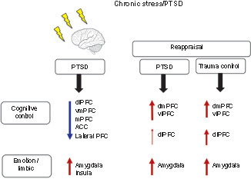
Figure 3 Summary of general brain activity and brain activity during reappraisal in individuals with PTSD. In general, individuals with PTSD have hypoactivation in a variety of frontal cortical regions involved in cognitive control and corresponding hyperactivation in the amygdala and insula. Reappraisal in PTSD in response to negative stimuli results in increases in dmPFC, dlPFC, and amygdala, but there is less activation in the dlPFC compared to trauma control.

